Slide 1
Dom Manipulation
-by Nitesh

Slide 2
What the heck is the DOM?
Document Object Model
  Your web browser builds a model of the web page (the document) that includes all the objects in the page (tags, text, etc)
  All of the properties, methods, and events available to the web developer for manipulating and creating web pages are organized into objects
  Those objects are accessible via scripting languages in modern web browsers

Slide 3
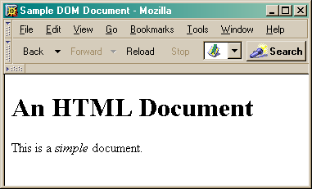
This is what the browser reads (sampleDOM.html).
<html>
<head>
<title>Sample DOM Document</title>
</head>
<body>
<h1>An HTML Document</h1>
<p>This is a <i>simple</i> document.
</body>
</html>
This is what the browser displays on screen.

Slide 4
Document
This is a drawing of the model that the browser is working with for the page.
<html>
<head>
<body>
<title>
"Sample DOM Document"
<h1>
<p>
"An HTML Document"
"This is a"
<i>
"document"
"simple"

Slide 5
document
  The root of the tree is an object of type HTMLDocument
  Using the global variable document, we can access all the nodes in the tree, as well as useful functions and other global information
    title, referrer, domain, URL, body, images, links, forms, ...
    open, write, close, getElementById, ...

Slide 6
Accessing DOM elements
Various method of accessing dom elements
1.getElementById()
2.getElementsByClassName()
3.getElementsByTagName()
4.getQuerySelector()
5.getQuerySelectorAll()

Slide 7
DOM Properties
innerText
innerHtml
textContent

